Slide 1

Introducing Apache Hadoop
螺丝工作室例会
张德通
2016/04/10

Slide 2
大数据是什么
https://www.youtube.com/watch?v=TzxmjbL-i4Y

Slide 3
所谓大数据的应用场景
医疗
城市管理（https://www.gzdata.com.cn/）
金融交易
IoT
Notes:
1 10TB
2 high calculation complexity,like statistical simulations.

Slide 4
是什么
a framework that allows for the distributed processing of large data sets across clusters of computers using simple programming models
scale up from single servers to thousands of machines, each offering local computation and storage
detect and handle failures at the application layer, so
delivering a highly-available service on top of a cluster of computers
Notes:
The Apache Hadoop software library is a framework that allows for the distributed processing of large data sets across clusters of computers using simple programming models. It is designed to scale up from single servers to thousands of machines, each offering local computation and storage. Rather than rely on hardware to deliver high-availability, the library itself is designed to detect and handle failures at the application layer, so delivering a highly-available service on top of a cluster of computers, each of which may be prone to failures.
hadoop 是作者的女儿的一只玩具大象的名字。
opensource under apache licence
apache项目基金会
https://www.youtube.com/watch?v=FHVuRxJpiwI&nohtml5=False&spfreload=10

Slide 5
是什么
A scalable fault-tolerant distributed system for data storage and processing (open source under the Apache license).
The project includes these modules:
Hadoop Common: The common utilities that support the other Hadoop modules.
Hadoop Distributed File System (HDFS): A distributed file system that provides high-throughput access to application data.
Hadoop YARN: A framework for job scheduling and cluster resource management.
Hadoop MapReduce: A YARN-based system for parallel processing of large data sets.
Notes:
core
1 storing files
2 running application on top of hadoop
hadoop: opening system, propersly built for data processing, can be installed on many nodes and make them look like one big mainframe.
distrabuted file system: big files, many files.
mapreduce: processes data in a unique way--for big data sets takes time to transfer on internet. processing the software where the data is stored.

Slide 6
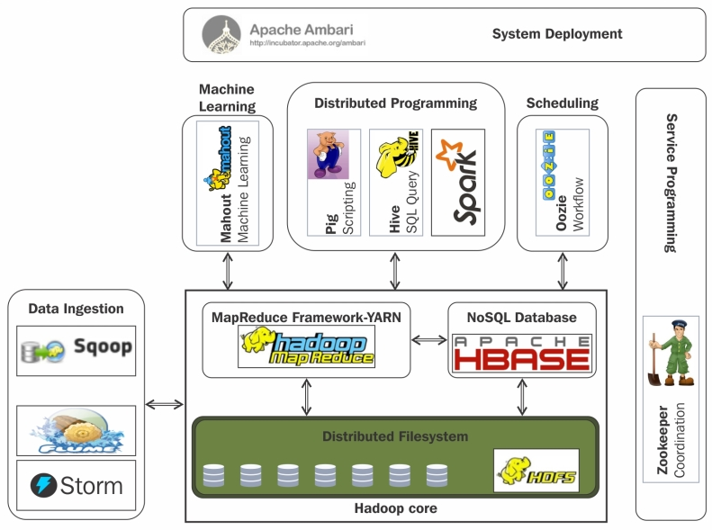
Hadoop生态系统
Notes:
HBase是一个开源的非关系型分布式数据库（NoSQL），它参考了谷歌的BigTable建模，实现的编程语言为 Java。它是Apache软件基金会的Hadoop项目的一部分，运行于HDFS文件系统之上，为 Hadoop 提供类似于BigTable 规模的服务。因此，它可以容错地存储海量稀疏的数据。
ZooKeeper是Apache软件基金会的一个软件项目，他为大型分布式计算提供开源的分布式配置服务、同步服务和命名注册
Storm是一个分布式计算框架。
Pig is a high-level platform for creating MapReduce programs used with Hadoop.
Apache Hive是一个建立在Hadoop架构之上的数据仓库。
Apache™ Mahout is a library of scalable machine-learning algorithms, implemented on top of Apache Hadoop® and using the MapReduce paradigm.

Slide 7
HDFS hadoop distributed filesystem
hdfs以流数据的访问模式来存储超大文件
超大文件指的是几班MB/GB/TB的文件
流式数据访问
商用硬件，即常见的普通硬件
Notes:
流式数据访问： 一次写入多次读取
不适用情况：
低延迟的数据访问——>hbase是替代选项，hdfs追求的是高数据吞吐量，会一定程度增加时间延迟
大量小文件——>与文件系统的概念有关，消耗内存
多用户写入，任意修改文件

Slide 8
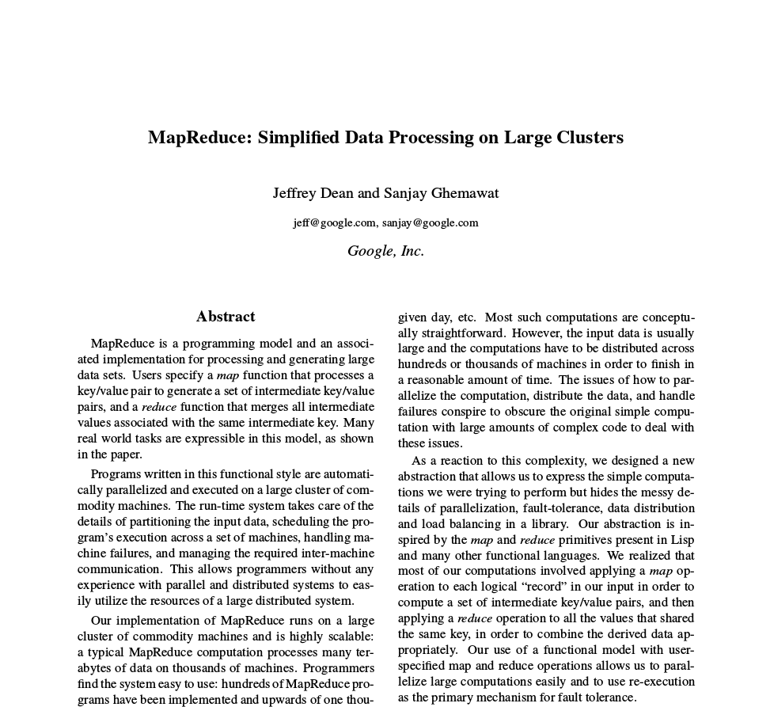
Notes:
scheduling system
programming modle
processing on distributed containers - map
brings the answer back - reduce
jeffery dean段子：
Jeff还是会在提交代码前把它们编译一遍，不过这么做的目的只是为了检查下编译器和链接器有没有bug
编译器从来不给Jeff编译警告，而是Jeff警告编译器
https://www.youtube.com/watch?v=9s-vSeWej1U&nohtml5=False&spfreload=10

Slide 9
MapReduce
Google提出的一个软件架构，用于大规模数据集（大于1TB）的并行运算
当前的软件实现是指定一个Map（映射）函数，用来把一组键值对映射成一组新的键值对，指定并发的Reduce（归纳）函数，用来保证所有映射的键值对中的每一个共享相同的键组
Notes:
Map（映射）”和“Reduce（归纳）”，及他们的主要思想，都是从函数式编程语言借来的，还有从矢量编程语言借来的特性。

Slide 10
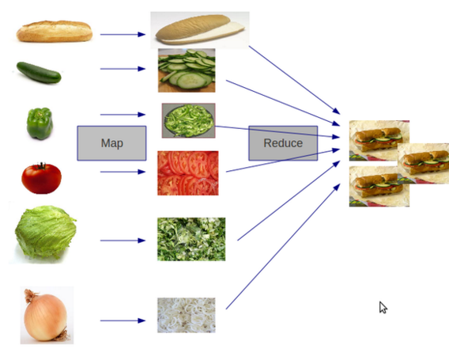
MapReduce

Slide 11
MapReduce
"Map"
"Shuffle"
"Reduce"
https://www.youtube.com/watch?v=bcjSe0xCHbE
Notes:
对于Map phase，又主要包含四个子阶段：从磁盘上读数据-》执行map函数-》combine结果-》将结果写到本地磁盘上；
对于reduce phase，同样包含四个子阶段：从各个map task上读相应的数据（shuffle）-》sort-》执行reduce函数-》将结果写到HDFS中。

Slide 12
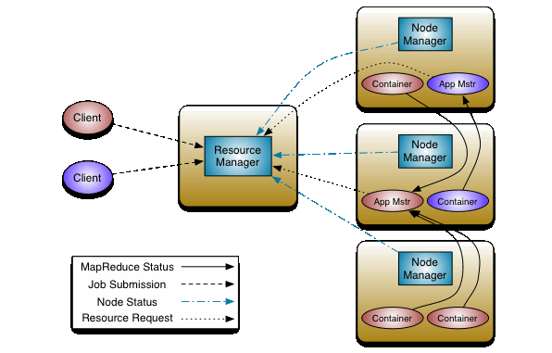
Yarn Yet Another Resource Negotiator
资源调度
资源隔离
弹性收缩
容灾容错
Notes:
MR on yarn, Storm on yarn, hbase on yarn, spark on yarn
container

Slide 13
Yarn container
It represents a resource (memory) on a single node at a given cluster.
A container is
supervised by the node manager
scheduled by the resource manager
One MR task runs in such container(s).
Notes:
Container是一种分配形式，contianer是yarn的resourceManager为ResourceRequest成功分配资源的结果。container为应用程序授予在特定主机上使用资源（内存/cpu）的资格
container是单个节点上如ram、cpu核和磁盘等物理资源的集合。系统中的每个节点可以恩威是有内存和cpu的最小容量的多个container组成

Slide 14
废话

Slide 15

英特尔杯
http://www.swcontest.net/index.php?a=intro&m=news#said_introd

Slide 16
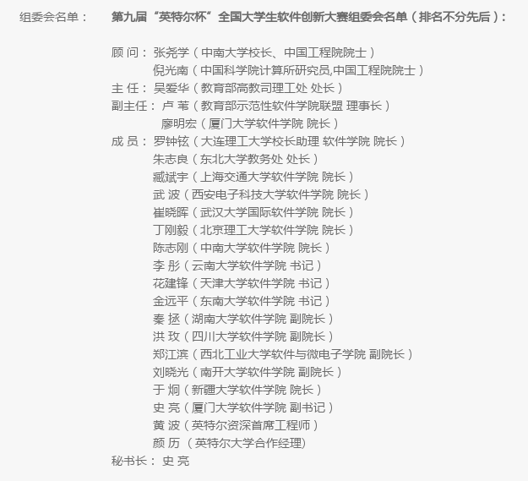

Slide 17
完

